Slide 1
EE542 Lab3
Fast, Reliable File Transfer
Team member:
Ziyao Yang
Xueting Jin

Slide 2
Introduction
Based on the first lab, we will explore the real world implications of how TCP performs under less than perfect conditions. Although TCP can provide reliable data transmission, but the transmission speed is not idea, especially comparing to UDP. The goal of this lab is to develop a protocol that can obtain both Fast and Reliable features .
Adding 200ms delay at both sides, and 20% loss.
Capable of sending at least 1GB file
Minimum speed limits: 200Mbps

Slide 3
Essential commands
Essential commands
add 200ms delay on both side, and total 20% loss by using the following command
-sudo tc qdisc set dev enps0 root netter delay 200ms loss 10%
Or
-sudo tc qdisc change dev enps0 root netter delay 200ms loss 10%
ping server and client using following command
on the client side:
-ping 162.198.0.100
one the server side:
-ping 162.198.0.200
(162.198.0.100 and 162.198.0.200 are the static IP address for server and client correspondingly.)
Then we can compile both server and client codes and sending files.

Slide 4
Design principle (Client & Server)
Client:
Creating socket 2
200ms delay
10% loss
Request file to send
Save accepted packets to buffer
Sending resend request when there is out of order packets
Sending ACKs when received expecting group of packets
Write the data into files when buffer is full, and clear the buffer for next group of packets
Server:
Creating socket 2
200ms delay
10% loss
Sending packets to client
Sending signal packets to client to indicate the end of the packet group
Resend packet when received resend requests
Send next group of packets when received ACKs

Slide 5
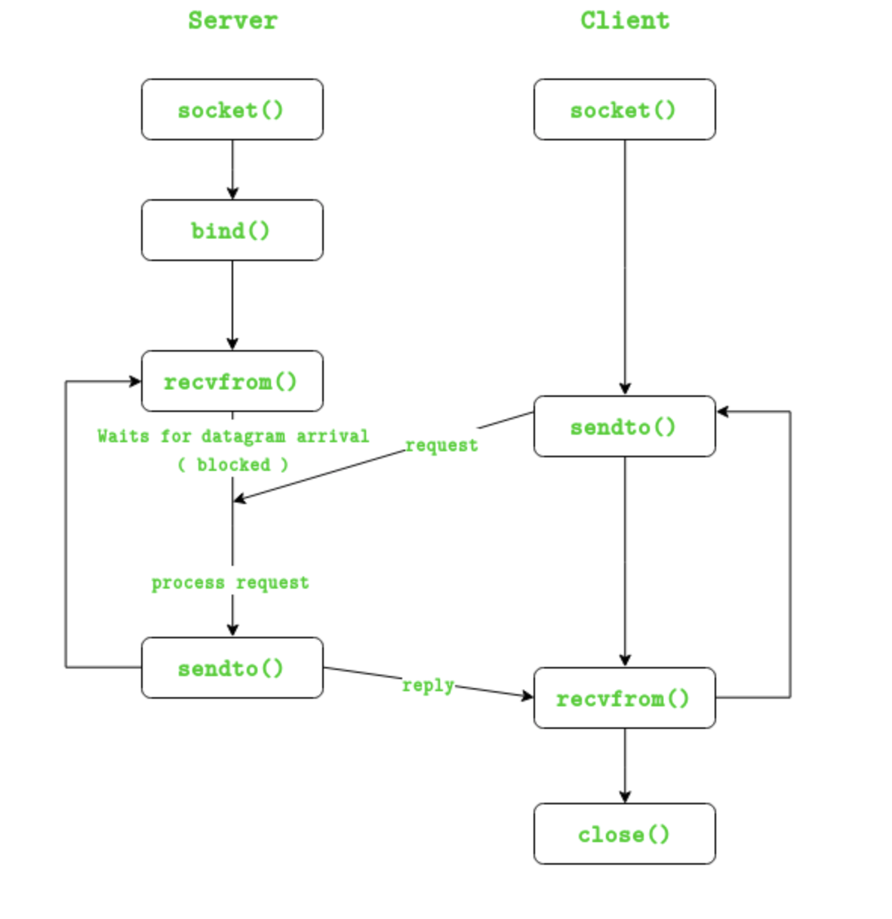
code - creating socket
In this part of the code, it is very similar to the lab1, we are creating socket on both server and client side, so that they can have data communication through the socket. In this lab we are using UDP socket
The process of creating a socket is shown as follow:

Slide 6
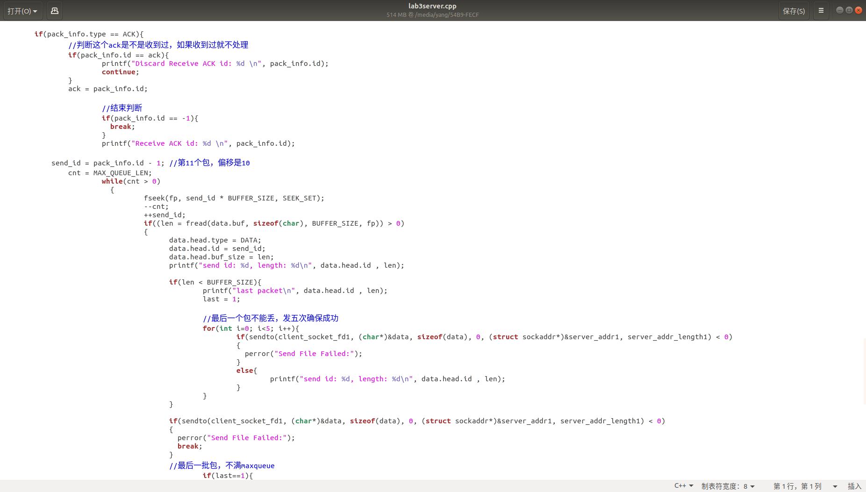
Code-server
There are two main functions for server:
Creating 2 sockets, one is used for receiving signal packets from client; one is used for sending data
Sending data that needed from client side. Ex: if client send ACK, server send next group of packets; if client send Resend request, server resend the corresponding packet

Slide 7
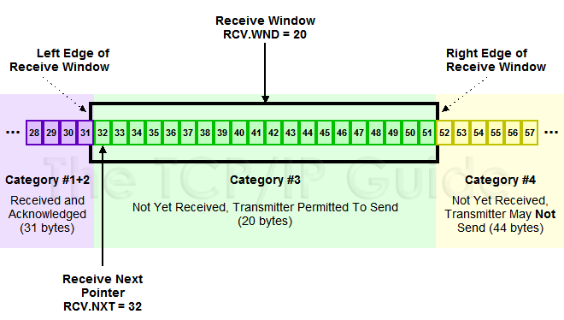
client (buffer)
In our design, we are sending packets as a group, the group size is equal to the buffer size, when the buffer is full and the packets is received in order, then when we received the “next group” signal from client, we will starting to send the next group of packets.
After we received the first round of data, we will scan the buffer. When there is packet missing (out of order), then client will send a resend request to server, then server will send that packet again, then we scan the buffer again. Once the buffer is full, we change thread to write.

Slide 8
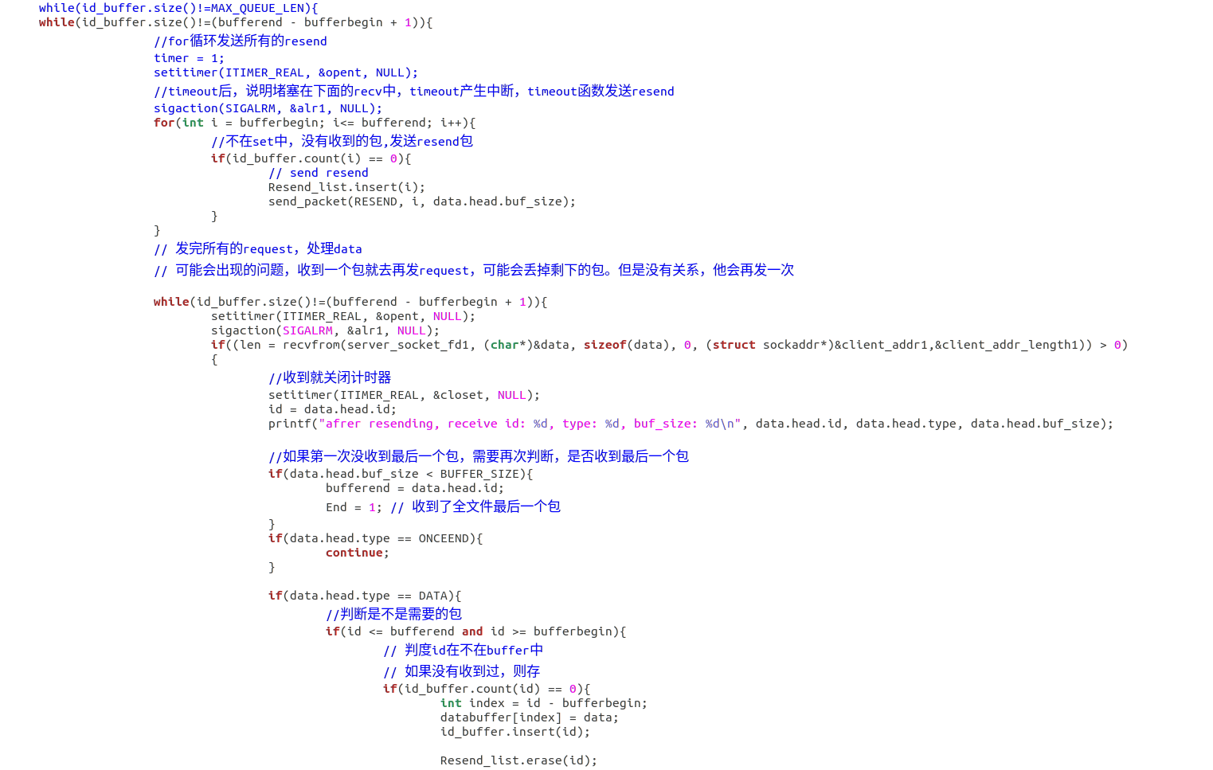
Code - client (resend request)
As we have added 20% loss in the file transmission, so that there will be packets get dropped during the transmission. At this time, we need to retransmit those lost packets again.
We are doing this by sending a resend request to server, so that server will know that we need it to retransmit a specific packets.

Slide 9
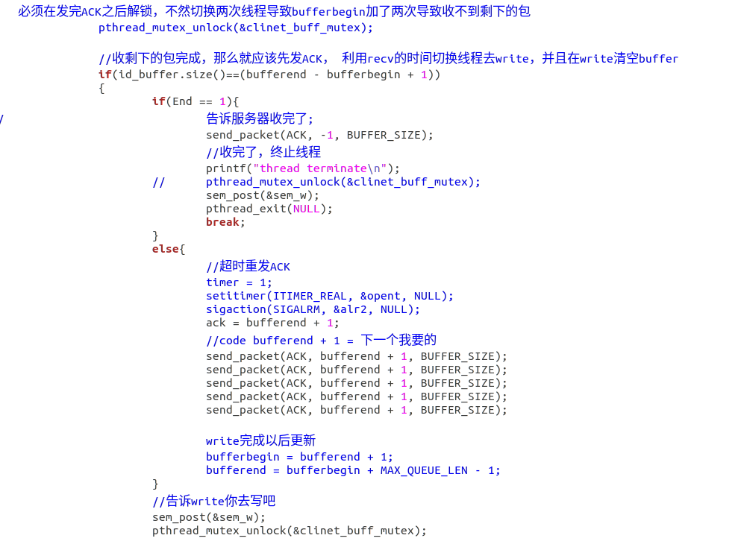
Code - Client (ACK)
ACK-Acknowledgement
This i the same with normal TCP ACK packets. When we have received a group of packets in whole and in order, then client will send a ACK to server to tell him that i have already received the group and please send the next group.

Slide 10
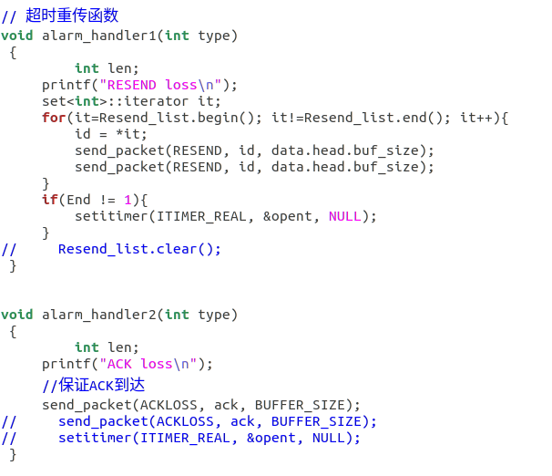
Code - client (timeout)
There are only one place that we have implemented the timeout algorithm, which is in the send resend request function.
When client is sending the resend request, once this resend packet is lost, then the program will get stuck there, so we set a timeout here to resend the resend request again just in case this important signal packet get lost.

Slide 11
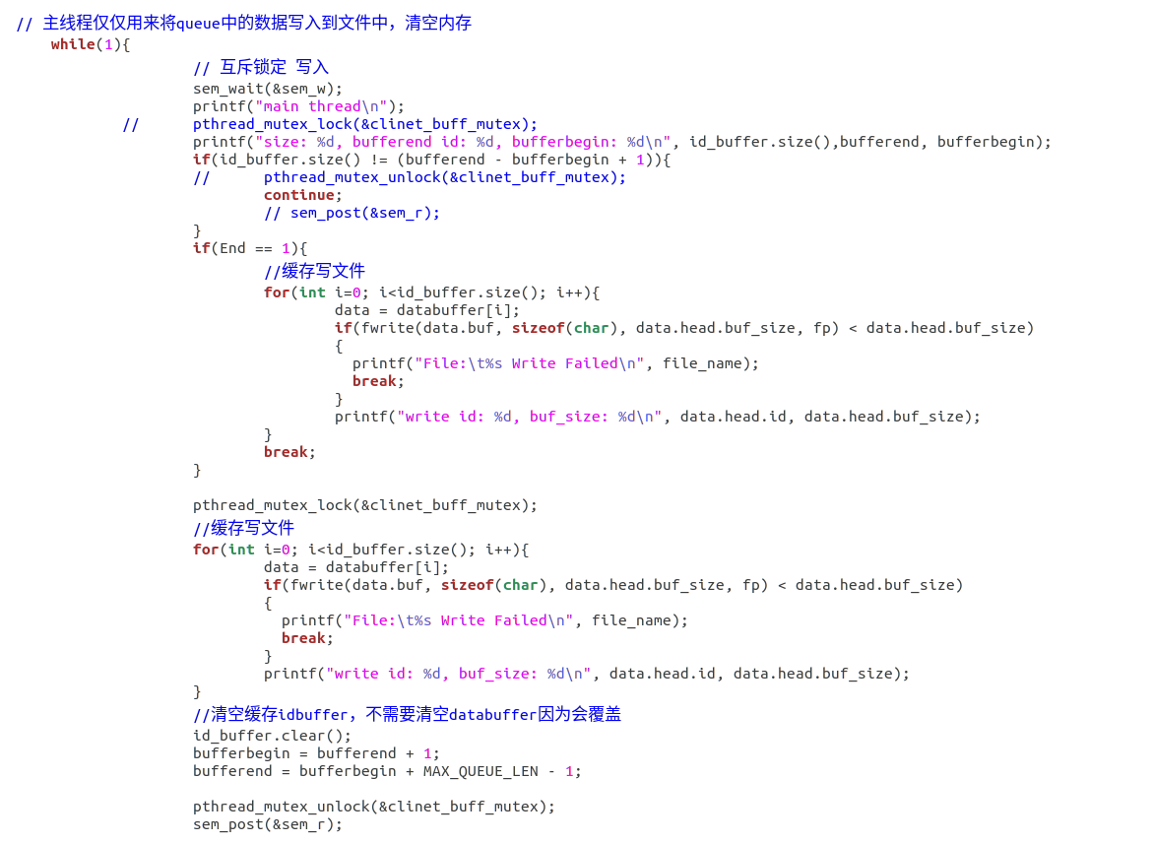
Code - client (write)
For one group of packets, once the buffer is full, which also means that we have received this group of packets in order. Then we change thread to write those received data into files, then we can clear out the buffer for the next group of packets

Slide 12
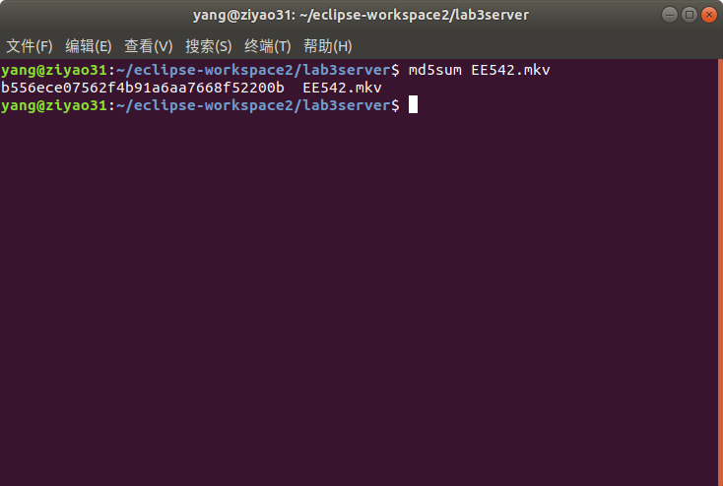
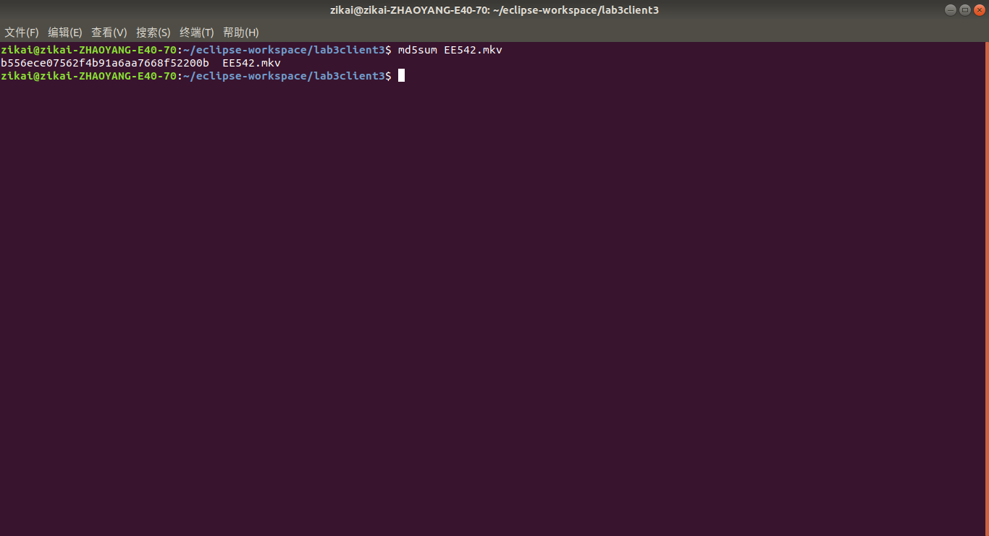
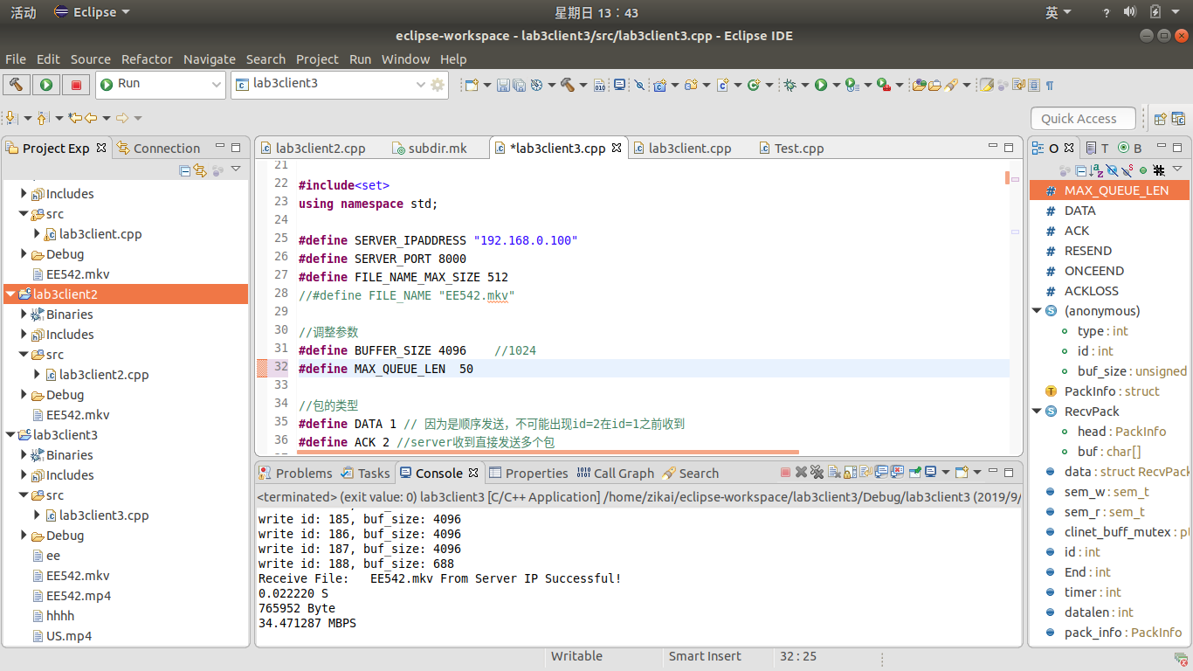
Results & Analysis
As you can see in the pictures, that we have received the exact the same file with the same size and with speed that over 200mbps

Slide 13
Thank you

